Slide 1
Big DATA Visualization

Slide 2
Big Data Visualization
Big data visualization is the representation of large sets of data through visual aids, whether that be through pie charts, heat maps, bar charts or any other kind of chart types or visual representation.
Analyzing and understanding large data sets and data analytics is no easy task and it can be especially difficult trying to relay that same information to colleagues who are not data-driven or data scientists.
That’s where big data visualization comes in. By transforming your large data sets into visually appealing infographics or interactive charts, you can easily convey your data points to fellow decision-makers.

Slide 3
Big Data Visualization
When your data is plotted out on graphs in a visual way and metrics are made easily readable, no data gets lost in the mix, no matter how large or small, and it makes decision-making for the future a breeze.
Because you can’t make adequate decisions or advance significantly without analyzing your raw data, it’s important that companies use great data visualization methods to keep everyone in the loop.

Slide 4
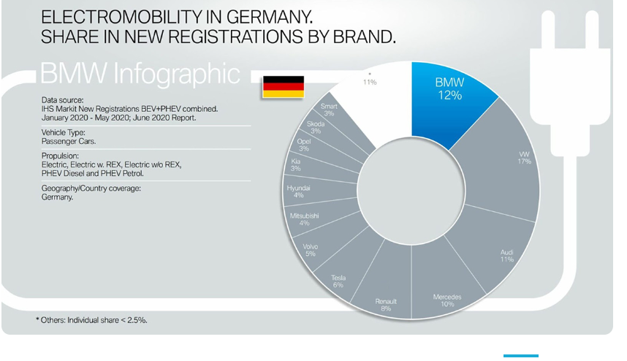
Let’s take BMW for example.

Slide 5
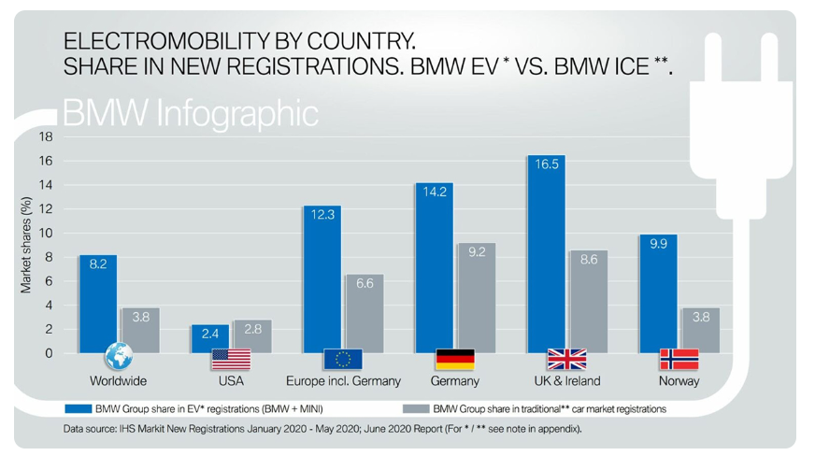
In 2020, BMW was able to track the number of sales for electric cars that they had and then compare it to other car companies’ sales, but not only. They also were able to track the countries that bought the highest amount of their electric cars.

Slide 6
This is a prime example of big data visualization in action. When you track your analytics and data, you can see where your wins are and when to celebrate or where your losses are and how you can make adjustments for the future.
Now, imagine for a moment that all this information was just written out plainly on a spreadsheet and had unstructured data all over it.
It would be hard to understand and assess how the company is doing and would take a long time to communicate to employees how their work has affected the sales of the cars.
This is why visualizing big data is so important. With just a glance and within seconds, you can easily see what cars are selling best and in what countries.
No time is wasted going through spreadsheets and trying to make sense of unstructured data — just visual analytics laid out for all to see and understand.

Slide 7
Why is Data Visualization Important in Big Data?
We live in a time where the internet and social media have exploded at an extraordinary rate, and information can be gathered within seconds and at the tips of anyone’s fingers.
With the rise of this technological era, it’s important that data can be visualized and consumed quickly and efficiently — especially since the human brain now has an attention span of about 8 seconds, according to this study by the Technical University of Denmark.
Because companies, businesses and organizations can gather data more quickly than ever, this means that they need to be able to visualize that data in an equally quick and easily consumable way.

Slide 8
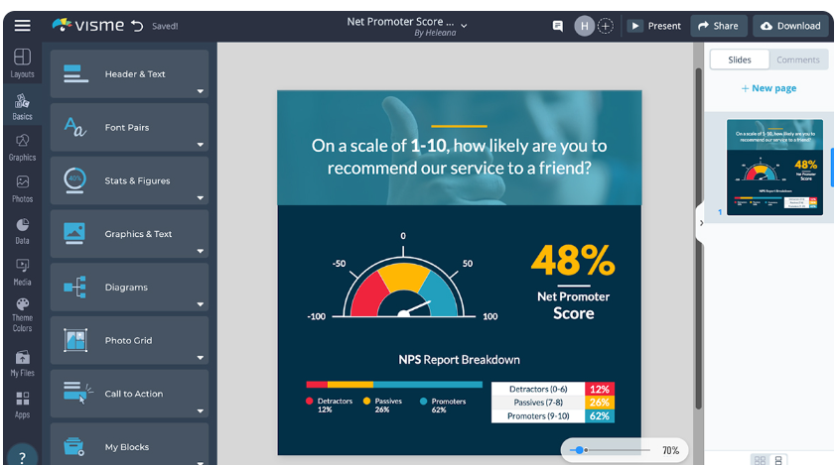
The best way to efficiently communicate your ever-coming, new data is through visualizing big data. This will bring your complex data to life and anyone who looks at it will be able to understand and grasp it with just a glance.

Slide 9
What Are the Types of Big Data Visualization?
There are lots of different types of data visualization that data analysts like to use and depending on the amount of data. A data analyst may choose to use a pie chart to express their numerical data or a bar chart.
When looking at big data analytics regarding locations, one might choose to use an interactive heat map or maybe a pivot table.
We’re going to look at 8 common types of big data visualization and some data visualization examples for each to help you decipher which one will work best for you.

Slide 10
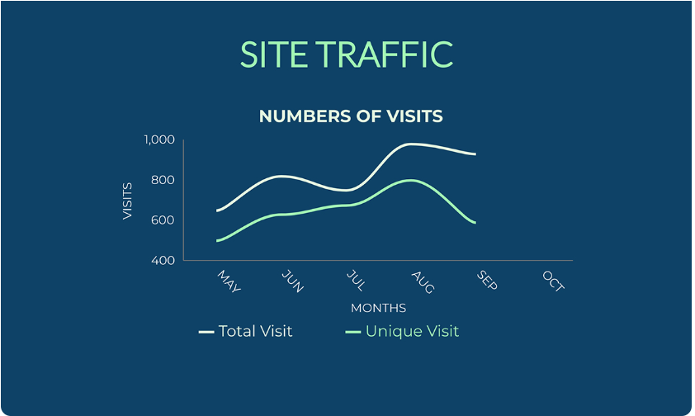
Type #1: Line Charts
A line chart, also known as a line graph, is a graphic representation of data that plots a fixed value on one side and a variable on the other.
A line chart is a fantastic way to represent the relationship of data. You can use a line chart to represent changes and fluctuations of things within a certain period of time.

Slide 11
Type #1: Line Charts
Strengths:
Excellent for showcasing trends and patterns in sequential or time-based data.
Effective for visualizing multiple variables or categories over time.
Suitable for highlighting continuous data trends and relationships.
Weaknesses:
Prone to overcrowding with massive datasets, leading to reduced readability.
Performance issues may arise when rendering a vast number of data points.
Detail loss and lack of granularity in extremely large datasets.

Slide 12

Type #2: Bar Charts
A bar chart, also known as a bar graph, uses bars to compare different data points or data sets.
Many data scientists will use bar charts to visually represent their data analysis. You can use a bar chart to compare large amounts of data, fluctuations of quantities or different categories.
The taller the bar, the larger the numerical value and vice versa.

Slide 13
Type #2: Bar Charts
Strengths:
Ideal for comparative analysis between discrete categories or groups.
Maintains readability by displaying distinct bars for each category.
Simplicity and clarity make it suitable for summarizing large datasets.
Weaknesses:
Less effective for representing trends or continuous data.
Space consumption increases with a vast number of categories or data points.
Provides less contextual information compared to line charts for trends over time.

Slide 14
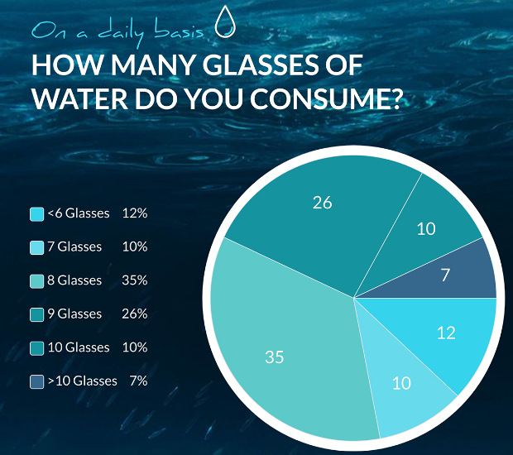
Type #3: Pie Charts
Pie charts, donut charts, circle graphs or whatever you choose to call them, are representations of data that are split into smaller segments and sizes to represent their numerical value.
When you use a pie chart, it becomes easy to see and compare how the different segments relate and differ from each other.
When using a pie chart, try not to overload it with too many different values. When you split the pie chart into more than 7 segments, it can become difficult to understand the data.

Slide 15
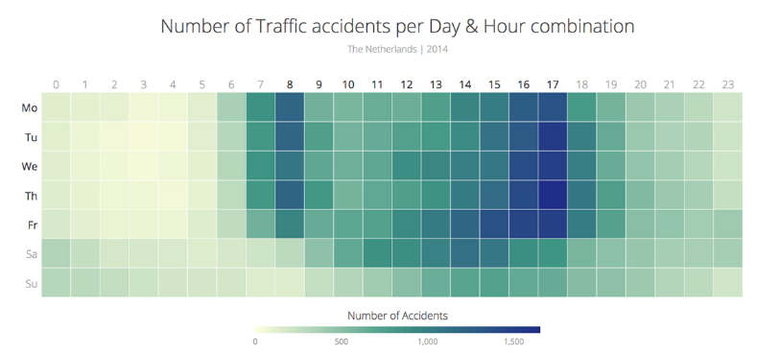
Type #4: Heat Maps
A heat map is a visual representation of data that is laid out on a map or table and uses different nuances and intensities of colors to represent its data.
Using a heat map can be especially helpful when you need to analyze data that seems to be never-ending. When you have an extremely wide value range, using a heat map makes it much more simple to quickly visualize and analyze large amounts of complex data at a glance.

Slide 16
Type #4: Heat Maps
Strengths:
Effective for displaying large volumes of data in a matrix format.
Suitable for identifying patterns, correlations, and hotspots in dense datasets.
Offers intuitive color gradients for representing varying data intensities.
Weaknesses:
May become visually cluttered and challenging to interpret with extremely large datasets.
Limited scalability when dealing with excessively high-resolution data.

Slide 17
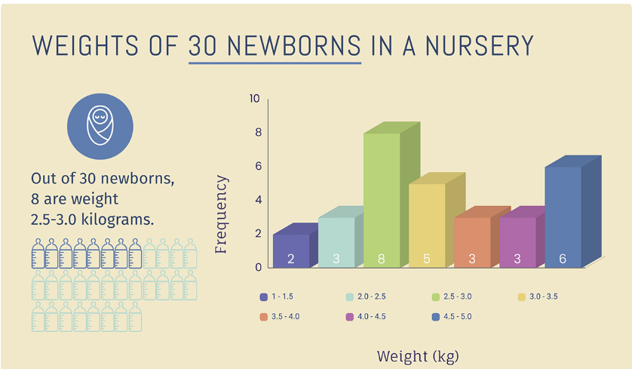
Type #5: Histograms
A histogram is a graphical and visual representation of complex data sets and the frequency of said numerical data displayed through bars.
Histograms are very similar to bar graphs but vary in the fact that they mostly focus on the repeated frequency of numerical data.

Slide 18
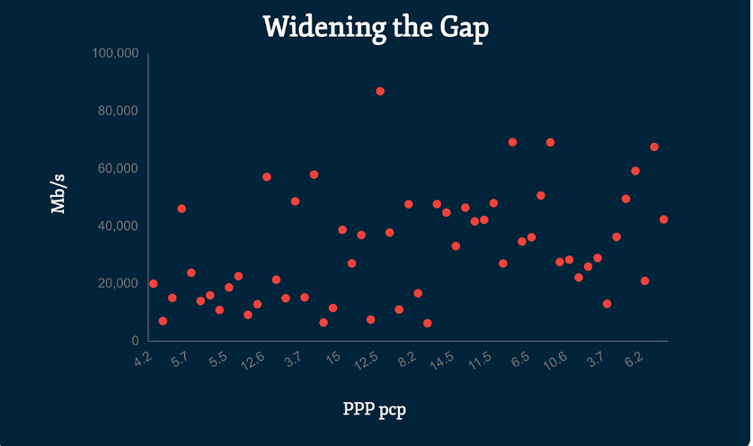
Type #6: Scatter Plots
A scatter plot, scatter chart or scatter graph, is a diagram that uses dots to represent and emphasize the different values of two or more numeric variables on an X and Y-axis.
Scatter plots are extremely useful to use when you have multiple large data sets and you want to know how they relate to each other and compare the importance of each value.

Slide 19
Type #6: Scatter Plots
Strengths:
Useful for visualizing relationships between two numerical variables.
Can display patterns, clusters, outliers, and correlations effectively.
Provides a quick overview of data distribution and trends.
Weaknesses:
Performance issues with extremely large datasets, as rendering thousands/millions of points can lead to clutter and slow visualization.
Difficulty in interpreting dense data due to overlapping points.

Slide 20

Type #7: Treemaps
Treemaps are the visual representation of hierarchical data by using color-coded rectangles.
Users can use treemaps as a method to compare multiple sets of data and reflect the weight of each value in a project.

Slide 21
Type #7: Treemaps
Strengths:
Ideal for hierarchical data representation, showing proportions within categories.
Efficiently displays large volumes of hierarchical data in a nested, space-filling layout.
Enables quick identification of larger categories based on area size.
Weaknesses:
Limited effectiveness when dealing with excessively complex hierarchies or deeply nested data, as readability decreases.
Small areas can be challenging to interpret, especially in highly populated treemaps.

Slide 22

Type #8: Funnel Charts
Funnel charts are typically used in sales and represent the different stages that your users or customers go through during the sales process and demonstrate decreasing values as they move through your funnel.
By using a funnel chart, you can accurately see where you are losing or gaining your customers during the sales process.

